Slide 1
unibz – Faculty of Computer Science
A.Y. 2016/2017
Studying the Change Impact of Self-Admitted Technical Debt for Reverting / Upgrading Software Versions
in Emergent Systems of Systems
Marta Pancaldi
Thesis Supervisor: Prof. Barbara Russo

Slide 2
SUMMARY
Idea and Approach:
Systems of Systems
Self-Admitted Technical Debt
Study Design
Analysis and Results

Slide 3
Main Idea
Is a newer version of code that maintains the same functionalities always better?

Slide 4
Emergence in Systems of Systems

Slide 5
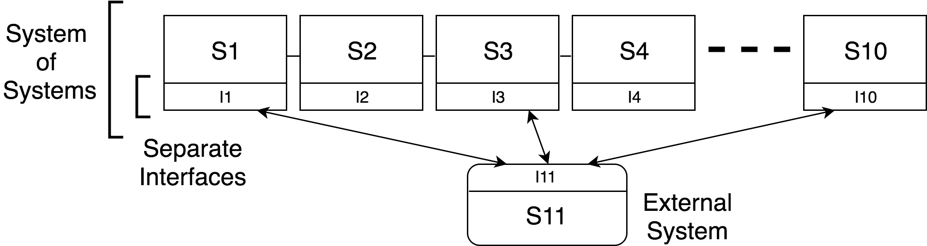
Example: Emergence in SoS & Design changes

Slide 6
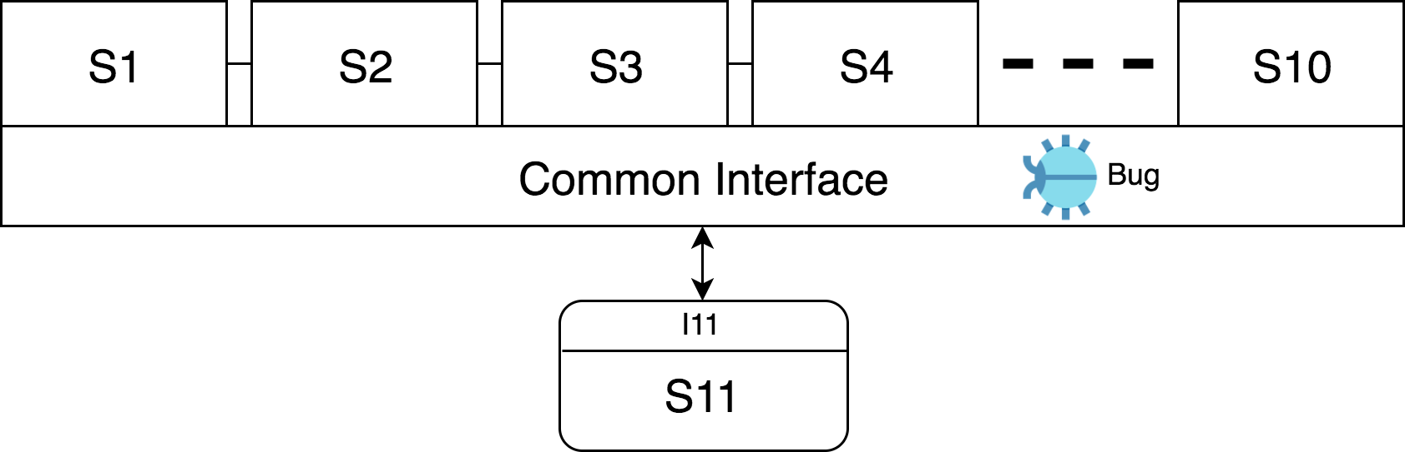
Example: Emergence in SoS & Design changes

Slide 7
Example: Emergence in SoS & Design changes

Slide 8
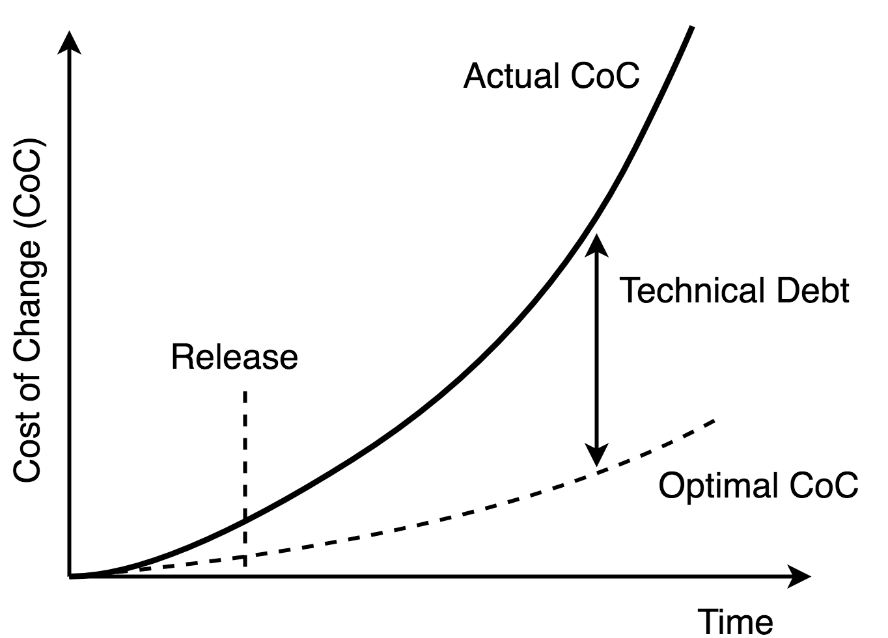
Technical Debt
Coined by W. Cunningham in 1992 as metaphor of financial debt
Prefer an easy, fast solution to a better implementation that requires more time
Can be intentional (“Self-Admitted”) or unintentional
¹ W. Cunningham, “The WyCash Portfolio Management System“

Slide 9
Self-Admitted Technical Debt (SATD)
Voluntary choice, often a trade-off between quality (e.g. performance, good design) and profit (meet deadlines, lower production cost, deliver software faster to the market)
Documented in source code comments
Many categories: Requirement, Documentation, Test, Design…
//TODO: is this the right thing to do?
//FIXME: needs to be rethought.

Slide 10
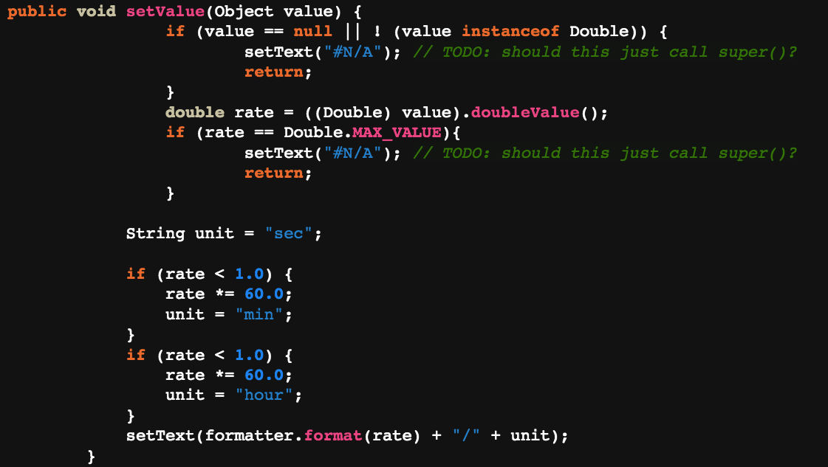
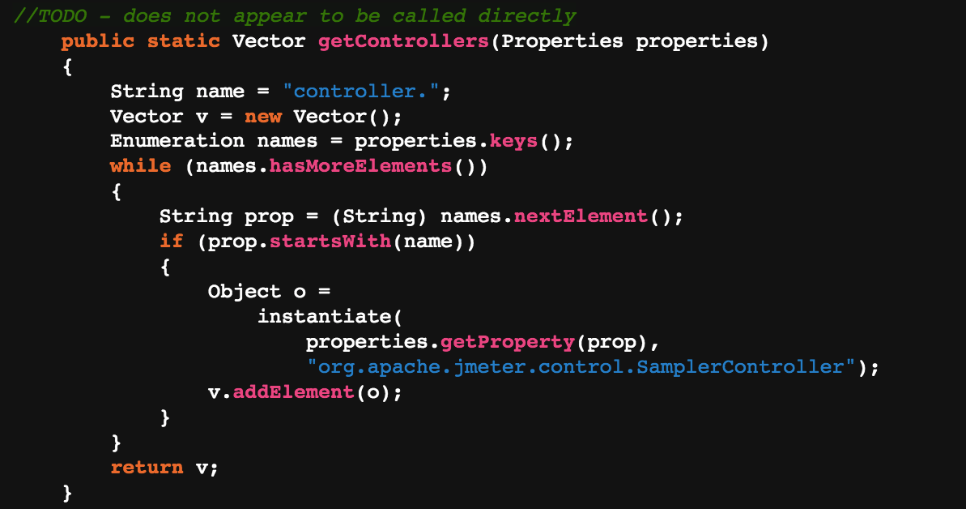
SATD-methods
SATD-comment outside the method
SATD-comment inside the method

Slide 11
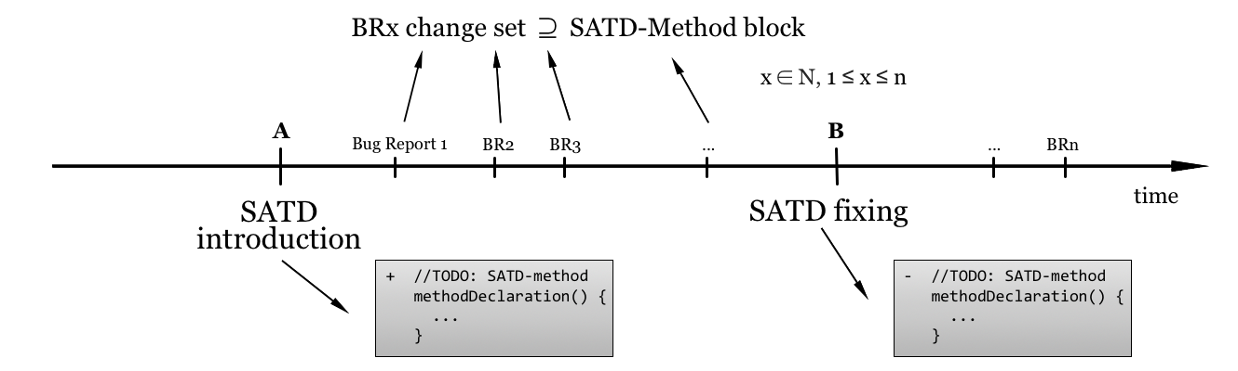
Study Design: SATD in source code

Slide 12
Data Extraction
350 SATD Design comments from 4 open-source projects ²
Git Log: retrieve introductory and fixing commits of each SATD
Git Show: extract code as it was at version X
Git Diff: obtain change set between two versions of code
Custom tools to extract SATD-methods and SATD-related changes
² E. Maldonado and E. Shihab, "Detecting and quantifying different types of self-admitted technical Debt”

Slide 13
Research Questions
RQ1: Change Impact of SATD-Introduction and Fixing
What is the relation between the code changed at SATD- introduction and the code changed at SATD-fixing?
RQ2: SATD-related Bug Reports
By fixing a SATD, does the code quality increase with respect to the time when the SATD was introduced?
RQ3: Evolution of SATD-Methods
How does a method M when a SATD is introduced evolves into M′, the same method when the SATD has been fixed?

Slide 14
Research Questions
RQ1: Change Impact of SATD-Introduction and Fixing
What is the relation between the code changed at SATD- introduction and the code changed at SATD-fixing?
RQ2: SATD-related Bug Reports
By fixing a SATD, does the code quality increase with respect to the time when the SATD was introduced?
RQ3: Evolution of SATD-Methods
How does a method M when a SATD is introduced evolves into M′, the same method when the SATD has been fixed?

Slide 15
Research Questions
RQ1: Change Impact of SATD-Introduction and Fixing
What is the relation between the code changed at SATD- introduction and the code changed at SATD-fixing?
RQ2: SATD-related Bug Reports
By fixing a SATD, does the code quality increase with respect to the time when the SATD was introduced?
RQ3: Evolution of SATD-Methods
How does a method M when a SATD is introduced evolves into M′, the same method when the SATD has been fixed?

Slide 16
Results – RQ1
Comparison between change impact at SATD-introduction vs. SATD-fixing
Change impact (at a version X) = lines changed ∩ lines in SATD-method at version X
43-67% of SATD instances: larger impact at SATD-fixing
24-37%: larger impact at SATD-introduction

Slide 17
Results – RQ1
Comparison between change impact at SATD-introduction vs. SATD-fixing
Change impact (at a version X) = lines changed ∩ lines in SATD-method at version X
43-67% of SATD instances: larger impact at SATD-fixing
24-37%: larger impact at SATD-introduction
⇒ Design Debt: code can be quick and dirty at SATD-introduction, while it must be accurate at fixing, so requires more effort

Slide 18
Results – RQ2
Heuristic tool that identifies Bug Reports related to SATD, based on lines changed in fixing change-files
Compare BRs found between SATD-introduction and fixing vs. between fixing and present time
53-80% of SATD instances: more bugs in “SATD-phase”
14-30%: more bugs after fixing

Slide 19
Results – RQ2
Heuristic tool that identifies Bug Reports related to SATD, based on lines changed in fixing change-files
Compare BRs found between SATD-introduction and fixing vs. between fixing and present time
53-80% of SATD instances: more bugs in “SATD-phase”
14-30%: more bugs after fixing
⇒ Presence of SATD caused more bugs on average
⇒ but also more Bugs after fixing in some cases

Slide 20
Results – RQ3
Compare sizes of SATD-methods at SATD-introduction vs. fixing
26-31% of SATD-instances: methods shrink
11-24%: methods grow
42-50%: methods are completely removed
3-9%: methods do not change
0

Slide 21
Results – RQ3
Compare sizes of SATD-methods at SATD-introduction vs. fixing
26-31% of SATD-instances: methods shrink
11-24%: methods grow
42-50%: methods are completely removed
3-9%: methods do not change
⇒ SATD-methods are often removed and replaced by improved versions, due to general design refactoring
0

Slide 22
Interpretation & Future Work
More expensive to pay back Design Technical Debt on average
Generally more Bugs before SATD-fixing
Most methods containing SATD are refactored

Slide 23
Interpretation & Future Work
More expensive to pay back Design Technical Debt on average
Generally more Bugs before SATD-fixing
Most methods containing SATD are refactored
⇒ Investigate cases with larger change effort at SATD-introduction and with more Bugs after SATD-fixing
⇒ Study and apply automated update / downgrade based on presence of Design SATD for SoS

Slide 24
Thanks

